Slide 1
Abandoned, hazardous and unregistered vehicles City Standards Committee 30 November 2021

Slide 2
Community value statement
Working together to make a difference to the people of Brisbane everyday, by improving the amenity and liveability of the City

Slide 3
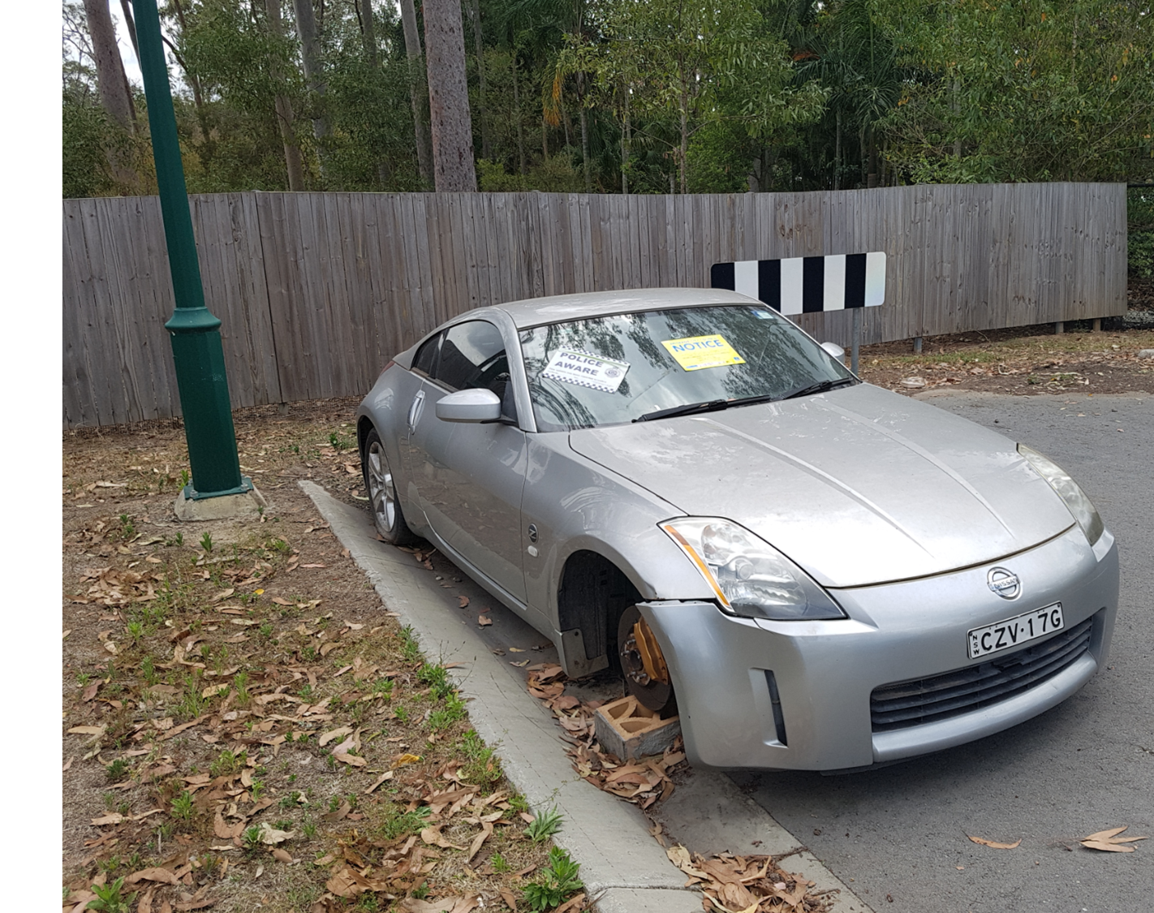
Overview
Approximately 5,600 reports relating to abandoned, hazardous and unregistered vehicles are received per year
Currently managed under the Public Land and Council Assets Local Law 2014
Respond to amenity-based complaints received under the Health, Safety and Amenity Local Law 2009
Council works with the Department of Transport and Main Roads (TMR) and Queensland Police Service (QPS)

Slide 4
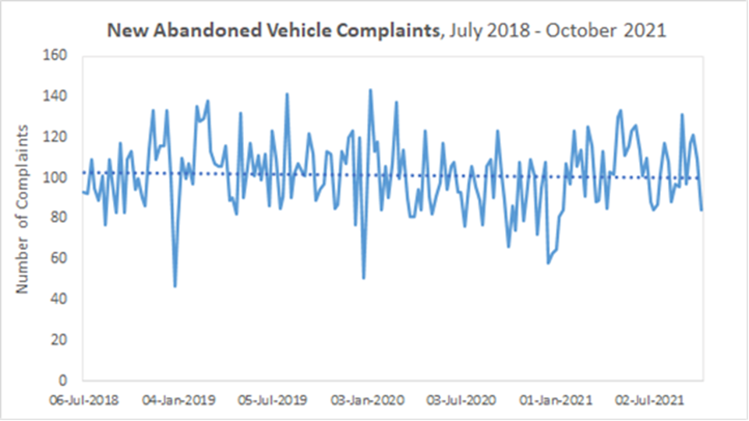
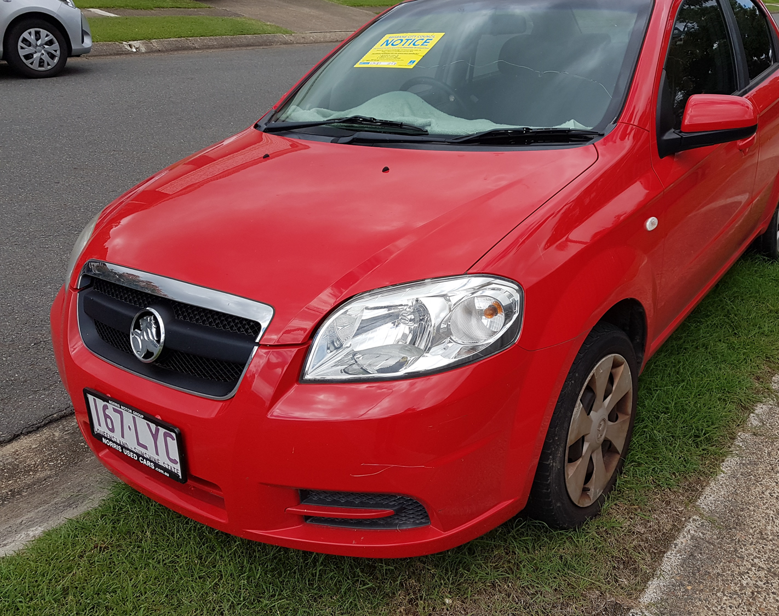
Volume of work

Slide 5
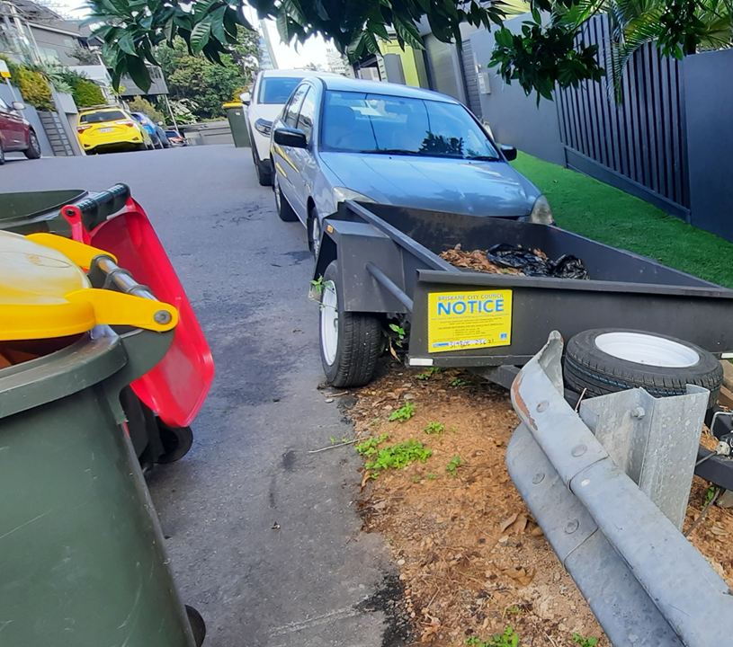
Breakdown of work
Between July 2017 and October 2021, a total of 28,035 complaints were received
Of the 28,035 reported:
67% were lodged by phone to the call centre
33% using the Report It online tool
Complaint data identifies that only 2,050 were reported as being illegally parked or causing a hazard
The yearly average complaint number is 5,600

Slide 6
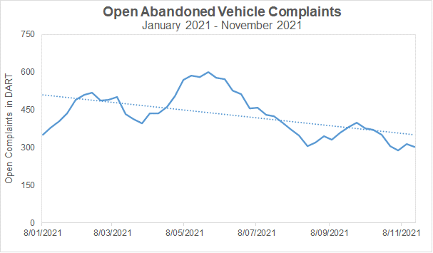
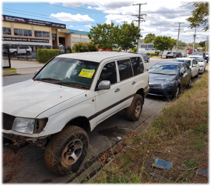
Process improvements
Improvements to the process commenced on 1 July 2021
Direct contact with the vehicle owner via text
Reducing time placing sticker on the vehicle concurrent to contacting the owner
Letterbox drop of flyers to houses immediately surrounding the vehicle
Reducing time between report and officer action (i.e., potential removal)
Reducing site visits by engaging complainant for updates

Slide 7
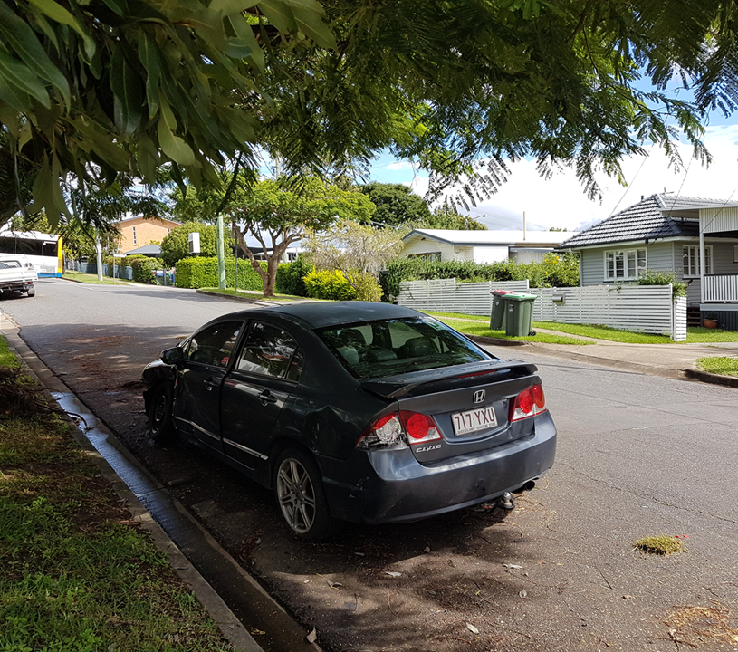
Challenges and opportunities
Challenges
Appropriateness of reporting
Lack of community awareness regarding unregistered vehicles
Identifying responsible person
Limited community safety hazards or amenity issues
Opportunities
Increasing community education
Continuing process improvement

Slide 8
Questions?

